Slide 1

Getting started with the Threat Modeling Tool
An introduction to security threat analysis
Notes:
AI-generated content may be incorrect. --- In this presentation, we will introduce the Threat Modeling Tool, a vital resource for identifying, analyzing, and mitigating potential security threats in software development. We will cover its purpose, how to start using it, and key features to help you effectively model threats.

Slide 2
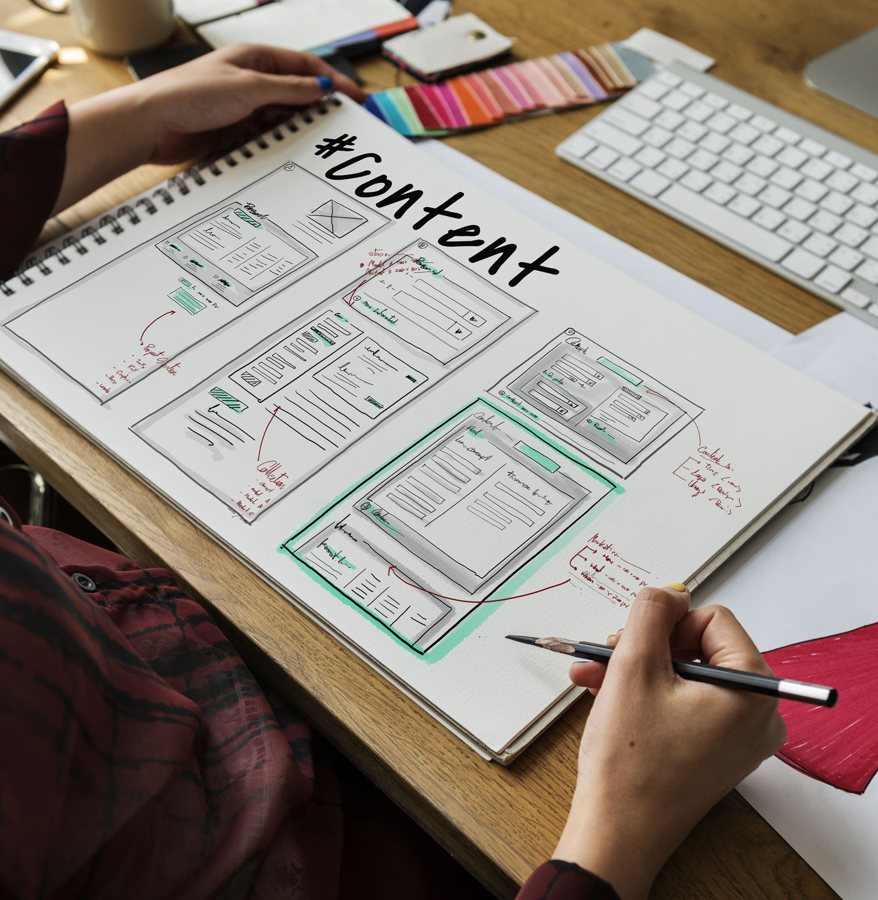
Agenda Items
Introduction to the Threat Modeling Tool
Starting the Threat Modeling Process
Building a Model
Analyzing Threats
Reports and Sharing
Next Steps and Updates
Notes:
We will begin with an introduction to the Threat Modeling Tool, including its overview and purpose, followed by the steps to initiate the threat modeling process. Next, we will build a model, analyze threats, generate reports, and discuss effective meetings for threat modeling. Finally, we will look at future updates and next steps for users.

Slide 3
🔍 Threat Modeling Tools Comparison Table
Tool | Features | Pros | Cons | Best For
Microsoft Threat Modeling Tool | - STRIDE-based - DFD diagramming - Auto-threat generation - Windows native app | ✅ Easy to use for beginners ✅ Auto-generated threats ✅ Free from Microsoft | ❌ Windows only ❌ Limited customization ❌ Not collaborative | Teams using STRIDE and Microsoft ecosystem
OWASP Threat Dragon | - Open-source - DFDs - Web & desktop apps - GitHub integration | ✅ Free & open-source ✅ Works on Linux/Mac/Windows ✅ Browser-based option | ❌ Fewer automation features ❌ UI can be basic ❌ Small dev community | Open-source and cross-platform environments
IriusRisk | - Risk-based modeling - Import from code - Compliance mapping - APIs | ✅ Enterprise-grade ✅ Supports DevSecOps pipelines ✅ Extensive reporting | ❌ Paid (expensive for small teams) ❌ Steep learning curve | Large enterprises and DevSecOps teams
Threagile | - YAML-based modeling - DevOps friendly - Auto risk generation | ✅ Code-as-model (CI/CD friendly) ✅ Lightweight ✅ Free and open-source | ❌ No GUI ❌ Requires YAML knowledge ❌ Limited for non-technical users | DevOps engineers and automation-heavy teams
SD Elements (Security Compass) | - Control libraries - Framework mapping - Jira/DevOps integration | ✅ Supports compliance standards ✅ Integration with Agile tools ✅ Scalable | ❌ Expensive ❌ More focused on requirements than diagrams | Regulated industries, Agile security teams

Slide 4
Scenario: XSS Attack on an E-commerce Website An attacker injects malicious JavaScript into the search bar, which gets stored and executed when users visit the affected page. This allows the attacker to steal session cookies. DREAD Scoring
Final Score Calculation
Category | Score (0-10) | Reasoning
Damage Potential | 7 | Users’ session cookies can be stolen, leading to account takeover.
Reproducibility | 9 | Very easy to reproduce with simple payloads.
Exploitability | 8 | No special tools needed, can be done using a browser.
Affected Users | 7 | Can impact many users, but depends on site traffic.
Discoverability | 9 | Easy for attackers to find using automated scanners.

Slide 5
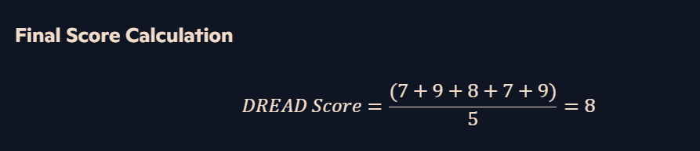

Slide 6
Scoring Guidelines
Category | Score Basis
Damage Potential | 0 = No impact, 5 = Minor data exposure, 8 = Sensitive data compromised, 10 = System destruction
Reproducibility | 0 = Nearly impossible, 5 = Complex but doable, 7.5 = Easy, 10 = Very easy to repeat
Exploitability | 2.5 = Requires advanced skills, 5 = Needs common tools, 9 = Can be done with proxies, 10 = Simple browser-based attack
Affected Users | 0 = No users affected, 2.5 = Individual users, 5 = Small group, 8 = Large-scale impact, 10 = Entire system affected
Discoverability | 0 = Nearly impossible to find, 5 = Requires effort, 7.5 = Easily detectable, 10 = Obvious to attackers

Slide 7
Introduction to the Threat Modeling Tool
Notes:
--- This slide references information from the following file: https://sidharthmahajanhotmail-my.sharepoint.com/personal/trainer_trainings_vinsys_com/_layouts/15/Doc.aspx?sourcedoc=%7B120D7389-5687-4024-8D66-9CDFDA274330%7D&file=Getting%20started%20with%20the%20Threat%20Modeling%20Tool.docx&action=default&mobileredirect=true Overview and Purpose, Summary of the SDL Threat Modeling Approach

Slide 8
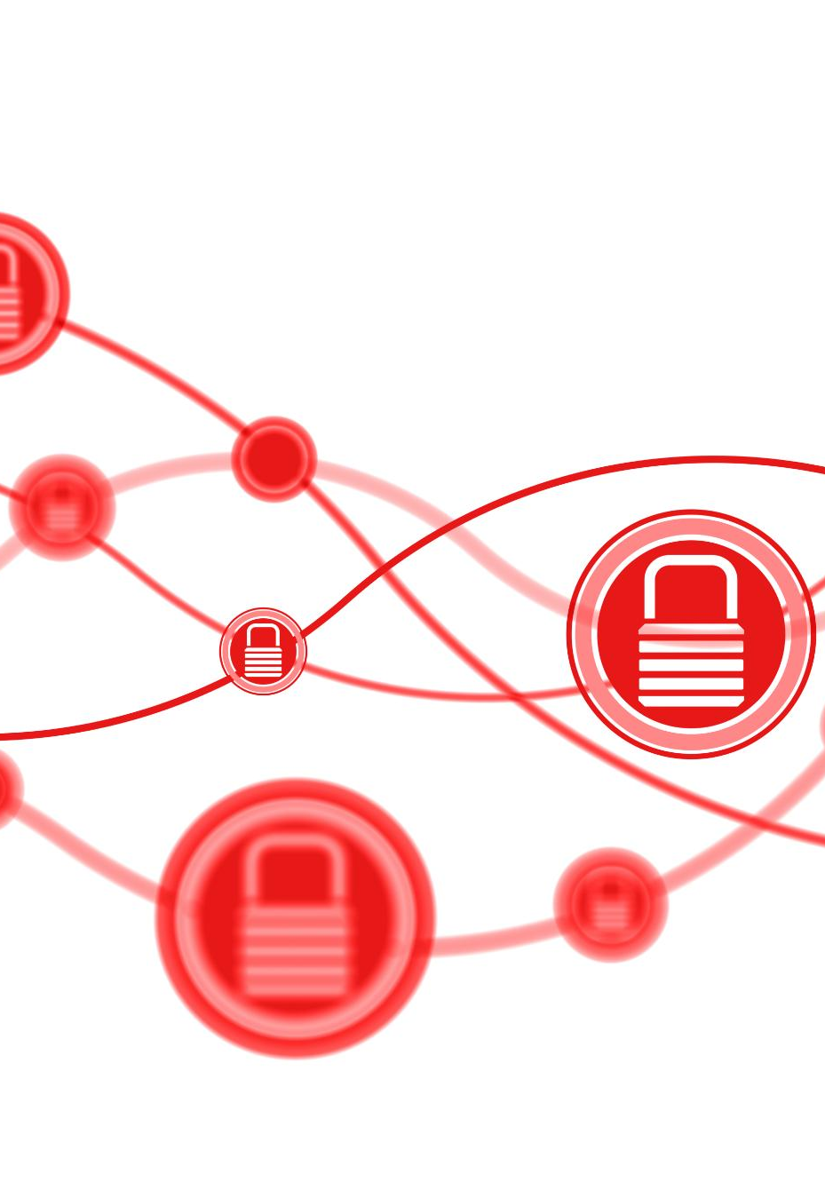
Overview and Purpose
Release of the Tool
The Microsoft Threat Modeling Tool 2018 was launched in September 2018 as a free download, enhancing accessibility for users.
Improved Delivery Mechanism
The tool's new delivery mechanism enables automatic updates, ensuring users have the latest features and bug fixes.
Using the Tool Effectively
This article guides users on how to effectively use the Microsoft SDL threat modeling approach to build robust threat models.
Notes:
--- This slide references information from the following file: https://sidharthmahajanhotmail-my.sharepoint.com/personal/trainer_trainings_vinsys_com/_layouts/15/Doc.aspx?sourcedoc=%7B120D7389-5687-4024-8D66-9CDFDA274330%7D&file=Getting%20started%20with%20the%20Threat%20Modeling%20Tool.docx&action=default&mobileredirect=true The Microsoft Threat Modeling Tool 2018 was released as GA in September 2018 as a free click-to-download. The change in delivery mechanism allows us to push the latest improvements and bug fixes to customers each time they open the tool, making it easier to maintain and use. This article takes you through the process of getting started with the Microsoft SDL threat modeling approach and shows you how to use the tool to develop great threat models as a backbone of your security process. This article builds on existing knowledge of the SDL threat modeling approach. For a quick review, refer to Threat Modeling Web Applications and an archived version of Uncover Security Flaws Using the STRIDE Approach MSDN article published in 2006.

Slide 9
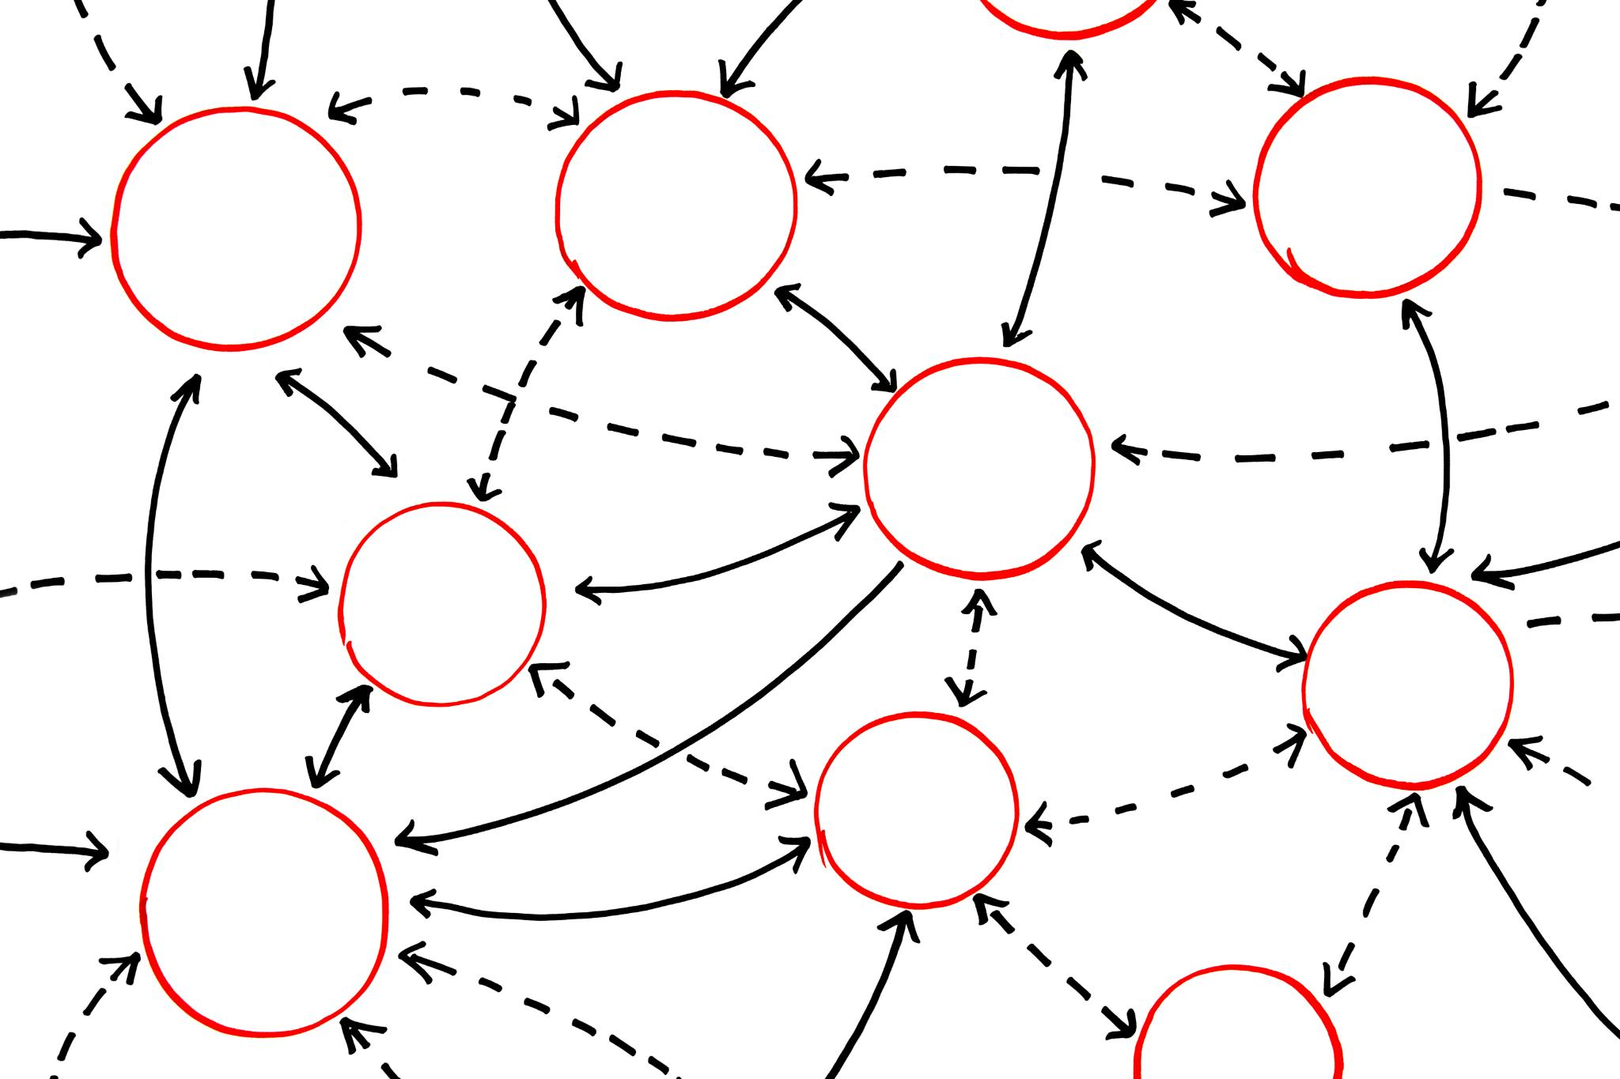
Summary of the SDL Threat Modeling Approach
Creating a Diagram
The first step in the SDL threat modeling approach is to create a detailed diagram of the system. This visual representation aids in understanding the architecture.
Identifying Threats
Once the diagram is created, potential threats to the system are identified. This step is crucial for understanding vulnerabilities.
Mitigation Strategies
After identifying threats, mitigation strategies are developed to address each threat effectively. This ensures the system's resilience.
Validation of Mitigations
The final step involves validating each mitigation strategy to ensure its effectiveness in reducing the identified threats.
Notes:
--- This slide references information from the following file: https://sidharthmahajanhotmail-my.sharepoint.com/personal/trainer_trainings_vinsys_com/_layouts/15/Doc.aspx?sourcedoc=%7B120D7389-5687-4024-8D66-9CDFDA274330%7D&file=Getting%20started%20with%20the%20Threat%20Modeling%20Tool.docx&action=default&mobileredirect=true To quickly summarize, the approach involves creating a diagram, identifying threats, mitigating them and validating each mitigation. Here’s a diagram that highlights this process:

Slide 10
Starting the Threat Modeling Process
Notes:
--- This slide references information from the following file: https://sidharthmahajanhotmail-my.sharepoint.com/personal/trainer_trainings_vinsys_com/_layouts/15/Doc.aspx?sourcedoc=%7B120D7389-5687-4024-8D66-9CDFDA274330%7D&file=Getting%20started%20with%20the%20Threat%20Modeling%20Tool.docx&action=default&mobileredirect=true Launching the Tool, Threat Model Section Components

Slide 11
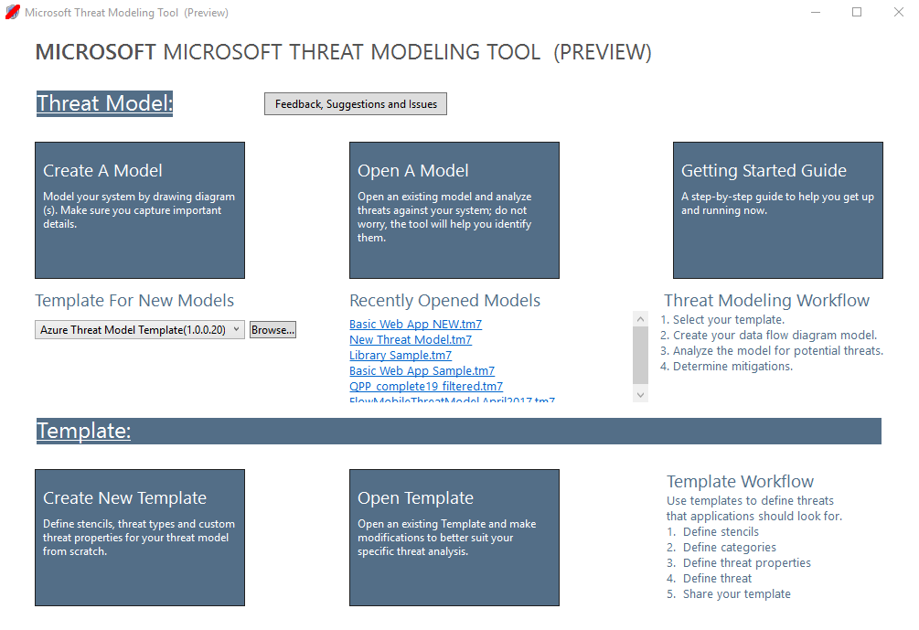
Launching the Tool
User Interface Overview
Upon launching the tool, familiarize yourself with the user interface and its main features for effective navigation.
Initial Features
The tool provides several initial features designed to streamline the threat modeling process, enhancing user experience.
Navigating the Tool
Understanding how to navigate through the tool is essential to efficiently start the threat modeling process.
Notes:
--- This slide references information from the following file: https://sidharthmahajanhotmail-my.sharepoint.com/personal/trainer_trainings_vinsys_com/_layouts/15/Doc.aspx?sourcedoc=%7B120D7389-5687-4024-8D66-9CDFDA274330%7D&file=Getting%20started%20with%20the%20Threat%20Modeling%20Tool.docx&action=default&mobileredirect=true Starting the threat modeling process When you launch the Threat Modeling Tool, you'll notice a few things, as seen in the picture:

Slide 12
Threat Model Section Components
Component | Details
Create New Template | Opens a blank template for you to build on. Unless you have extensive knowledge in building templates from scratch, we recommend you to build from existing ones
Open Template | Opens existing templates for you to make changes to
Notes:
Expand table

Slide 13
Building a Model
Notes:
--- This slide references information from the following file: https://sidharthmahajanhotmail-my.sharepoint.com/personal/trainer_trainings_vinsys_com/_layouts/15/Doc.aspx?sourcedoc=%7B120D7389-5687-4024-8D66-9CDFDA274330%7D&file=Getting%20started%20with%20the%20Threat%20Modeling%20Tool.docx&action=default&mobileredirect=true Developing a Threat Model, Example Walkthrough

Slide 14

Developing a Threat Model
Team Collaboration
The team members, including a developer, program manager, and tester, work together to create a comprehensive threat model.
Understanding Threats
Cristina, Ricardo, and Ashish analyze potential threats to their application, considering various risk factors and vulnerabilities.
Developing the Model
The team systematically builds their threat model by identifying assets, potential threats, and mitigation strategies.
Notes:
--- This slide references information from the following file: https://sidharthmahajanhotmail-my.sharepoint.com/personal/trainer_trainings_vinsys_com/_layouts/15/Doc.aspx?sourcedoc=%7B120D7389-5687-4024-8D66-9CDFDA274330%7D&file=Getting%20started%20with%20the%20Threat%20Modeling%20Tool.docx&action=default&mobileredirect=true Building a model In this section, we follow: Cristina (a developer) Ricardo (a program manager) and Ashish (a tester) They are going through the process of developing their first threat model.

Slide 15
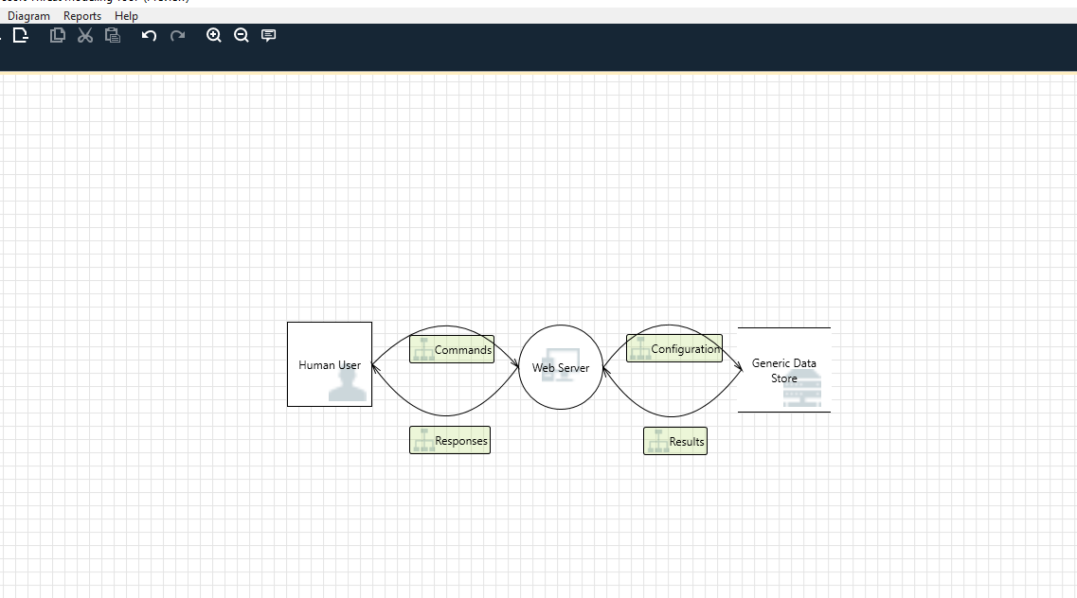
Example Walkthrough
Data Flow Diagram Overview
The DFD illustrates how data flows between entities, showing the user's interaction with the web server.
Trust Boundaries
Trust boundaries are indicated by red dotted lines, showing where control differs between entities like users and systems.
System Entities
Entities such as the human user, web server, and database are represented using distinct shapes in the DFD.
Notes:
--- This slide references information from the following file: https://sidharthmahajanhotmail-my.sharepoint.com/personal/trainer_trainings_vinsys_com/_layouts/15/Doc.aspx?sourcedoc=%7B120D7389-5687-4024-8D66-9CDFDA274330%7D&file=Getting%20started%20with%20the%20Threat%20Modeling%20Tool.docx&action=default&mobileredirect=true Ricardo: Hi Cristina, I worked on the threat model diagram and wanted to make sure we got the details right. Can you help me look it over? Cristina: Absolutely. Let’s take a look. Ricardo opens the tool and shares his screen with Cristina. Cristina: Ok, looks straightforward, but can you walk me through it? Ricardo: Sure! Here is the breakdown: Our human user is drawn as an outside entity—a square They’re sending commands to our Web server—the circle The Web server is consulting a database (two parallel lines) What Ricardo just showed Cristina is a DFD, short for Data Flow Diagram. The Threat Modeling Tool allows users to specify trust boundaries, indicated by the red dotted lines, to show where different entities are in control. For example, IT administrators require an Active Directory system for authentication purposes, so the Active Directory is outside of their control. Cristina: Looks right to me. What about the threats? Ricardo: Let me show you.

Slide 16
Analyzing Threats
Notes:
--- This slide references information from the following file: https://sidharthmahajanhotmail-my.sharepoint.com/personal/trainer_trainings_vinsys_com/_layouts/15/Doc.aspx?sourcedoc=%7B120D7389-5687-4024-8D66-9CDFDA274330%7D&file=Getting%20started%20with%20the%20Threat%20Modeling%20Tool.docx&action=default&mobileredirect=true Using the Analysis View, Understanding Generated Threats

Slide 17
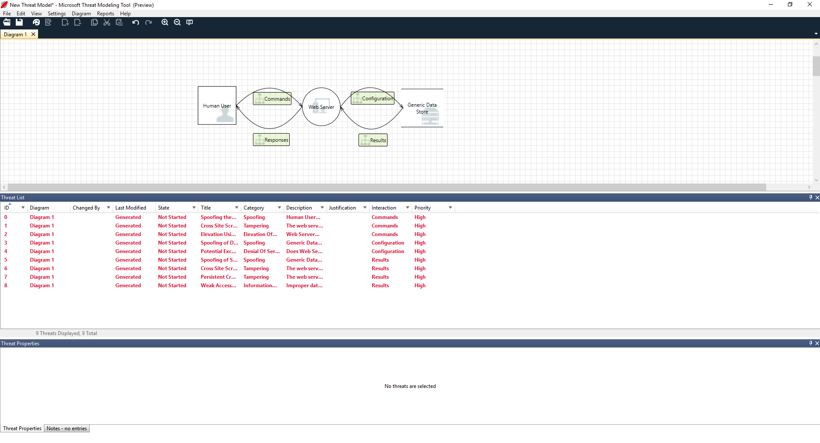
Using the Analysis View
Threat Modeling Overview
The analysis view provides an overview of potential threats identified through the Threat Modeling Tool, highlighting risks associated with software.
SDL STRIDE Categories
The SDL approach categorizes threats into six categories: Spoofing, Tampering, Repudiation, Info Disclosure, Denial of Service, and Elevation of Privilege.
Security Measures Analogy
Securing software is analogous to ensuring all doors and windows are locked before enhancing security measures like alarms.
Notes:
--- This slide references information from the following file: https://sidharthmahajanhotmail-my.sharepoint.com/personal/trainer_trainings_vinsys_com/_layouts/15/Doc.aspx?sourcedoc=%7B120D7389-5687-4024-8D66-9CDFDA274330%7D&file=Getting%20started%20with%20the%20Threat%20Modeling%20Tool.docx&action=default&mobileredirect=true Analyzing threats Once he clicks on the analysis view from the icon menu selection (file with magnifying glass), he is taken to a list of generated threats the Threat Modeling Tool found based on the default template, which uses the SDL approach called STRIDE (Spoofing, Tampering, Repudiation, Info Disclosure, Denial of Service and Elevation of Privilege). The idea is that software comes under a predictable set of threats, which can be found using these 6 categories. This approach is like securing your house by ensuring each door and window has a locking mechanism in place before adding an alarm system or chasing after the thief.

Slide 18
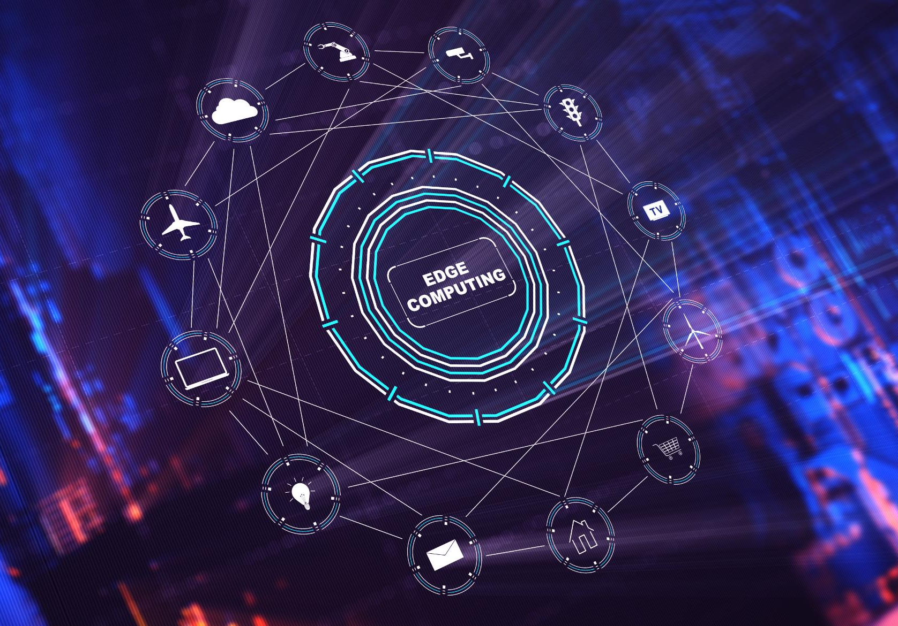
Understanding Generated Threats
Enhanced Interaction
The interaction between the two stencils improves threat analysis and understanding of design flaws.
STRIDE Categorization
STRIDE categorization helps identify potential attack vectors and understand vulnerabilities in the system.
Mitigation Strategies
The added descriptions and examples guide users on how to implement effective mitigations for identified threats.
Access Control Importance
Discussion on access control highlights the need for role implementation and proper account management.
Notes:
--- This slide references information from the following file: https://sidharthmahajanhotmail-my.sharepoint.com/personal/trainer_trainings_vinsys_com/_layouts/15/Doc.aspx?sourcedoc=%7B120D7389-5687-4024-8D66-9CDFDA274330%7D&file=Getting%20started%20with%20the%20Threat%20Modeling%20Tool.docx&action=default&mobileredirect=true Ricardo begins by selecting the first item on the list. Here’s what happens: First, the interaction between the two stencils is enhanced Second, additional information about the threat appears in the Threat Properties window The generated threat helps him understand potential design flaws. The STRIDE categorization gives him an idea on potential attack vectors, while the additional description tells him exactly what’s wrong, along with potential ways to mitigate it. He can use editable fields to write notes in the justification details or change priority ratings depending on his organization’s bug bar. Azure templates have additional details to help users understand not only what’s wrong, but also how to fix it by adding descriptions, examples and hyperlinks to Azure-specific documentation. The description made him realize the importance of adding an authentication mechanism to prevent users from being spoofed, revealing the first threat to be worked on. A few minutes into the discussion with Cristina, they understood the importance of implementing access control and roles. Ricardo filled in some quick notes to make sure these were implemented. As Ricardo went into the threats under Information Disclosure, he realized the access control plan required some read-only accounts for audit and report generation. He wondered whether this should be a new threat, but the mitigations were the same, so he noted the threat accordingly. He also thought about information disclosure a bit more and realized that the backup tapes were going to need encryption, a job for the operations team. Threats not applicable to the design due to existing mitigations or security guarantees can be changed to “Not Applicable” from the Status drop-down. There are three other choices: Not Started – default selection, Needs Investigation – used to follow up on items and Mitigated – once it’s fully worked on.

Slide 19
Reports and Sharing
Notes:
--- This slide references information from the following file: https://sidharthmahajanhotmail-my.sharepoint.com/personal/trainer_trainings_vinsys_com/_layouts/15/Doc.aspx?sourcedoc=%7B120D7389-5687-4024-8D66-9CDFDA274330%7D&file=Getting%20started%20with%20the%20Threat%20Modeling%20Tool.docx&action=default&mobileredirect=true Creating and Saving Reports, Sharing Files

Slide 20
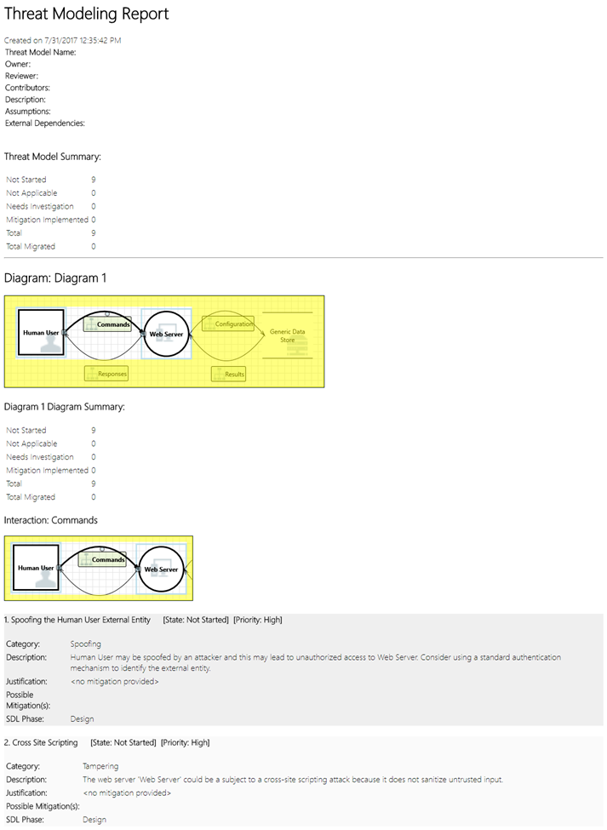
Creating and Saving Reports
Report Preparation
Ricardo collaborates with Cristina to review the list and add important notes and changes.
Creating Full Report
After adding necessary details, Ricardo selects the option to create a full report for documentation.
Saving and Printing Reports
Ricardo saves the report which allows for printing and sharing with colleagues for review.
Notes:
--- This slide references information from the following file: https://sidharthmahajanhotmail-my.sharepoint.com/personal/trainer_trainings_vinsys_com/_layouts/15/Doc.aspx?sourcedoc=%7B120D7389-5687-4024-8D66-9CDFDA274330%7D&file=Getting%20started%20with%20the%20Threat%20Modeling%20Tool.docx&action=default&mobileredirect=true Reports & sharing Once Ricardo goes through the list with Cristina and adds important notes, mitigations/justifications, priority and status changes, he selects Reports -> Create Full Report -> Save Report, which prints out a nice report for him to go through with colleagues to ensure the proper security work is implemented.

Slide 21
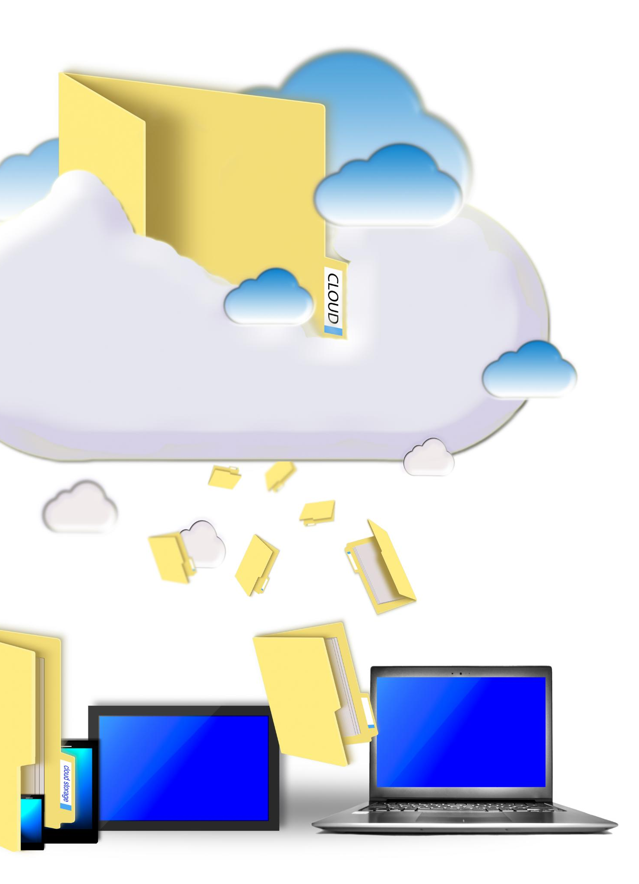
Sharing Files
OneDrive File Sharing
Ricardo can save files in his organization’s OneDrive account for easy access and sharing.
Copying Document Link
Once the file is saved, he can easily copy the document link to share with his colleagues.
Collaborative Access
Sharing the document link allows colleagues to access the file collaboratively, enhancing teamwork.
Notes:
--- This slide references information from the following file: https://sidharthmahajanhotmail-my.sharepoint.com/personal/trainer_trainings_vinsys_com/_layouts/15/Doc.aspx?sourcedoc=%7B120D7389-5687-4024-8D66-9CDFDA274330%7D&file=Getting%20started%20with%20the%20Threat%20Modeling%20Tool.docx&action=default&mobileredirect=true If Ricardo wants to share the file instead, he can easily do so by saving in his organization’s OneDrive account. Once he does that, he can copy the document link and share it with his colleagues.

Slide 22
Next Steps and Updates
Notes:
--- This slide references information from the following file: https://sidharthmahajanhotmail-my.sharepoint.com/personal/trainer_trainings_vinsys_com/_layouts/15/Doc.aspx?sourcedoc=%7B120D7389-5687-4024-8D66-9CDFDA274330%7D&file=Getting%20started%20with%20the%20Threat%20Modeling%20Tool.docx&action=default&mobileredirect=true Getting Started Guide and Support, Azure Stencil Updates

Slide 23
Getting Started Guide and Support
Contact Support
For assistance, send your questions and comments to the support email provided. Expert help is just an email away.
Download the Tool
Get started by downloading the Threat Modeling Tool, which will assist you in your threat modeling tasks.
Introduction to the Tool
Refer to the introductory guide to learn how to effectively use the Threat Modeling Tool for your needs.
Notes:
--- This slide references information from the following file: https://sidharthmahajanhotmail-my.sharepoint.com/personal/trainer_trainings_vinsys_com/_layouts/15/Doc.aspx?sourcedoc=%7B120D7389-5687-4024-8D66-9CDFDA274330%7D&file=Getting%20started%20with%20the%20Threat%20Modeling%20Tool.docx&action=default&mobileredirect=true Send your questions, comments and concerns to tmtextsupport@microsoft.com. Download the Threat Modeling Tool to get started. The Threat Modeling Tool can help you with your threat modeling needs. For a basic introduction to the tool, see Get started with the Threat Modeling Tool.

Slide 24
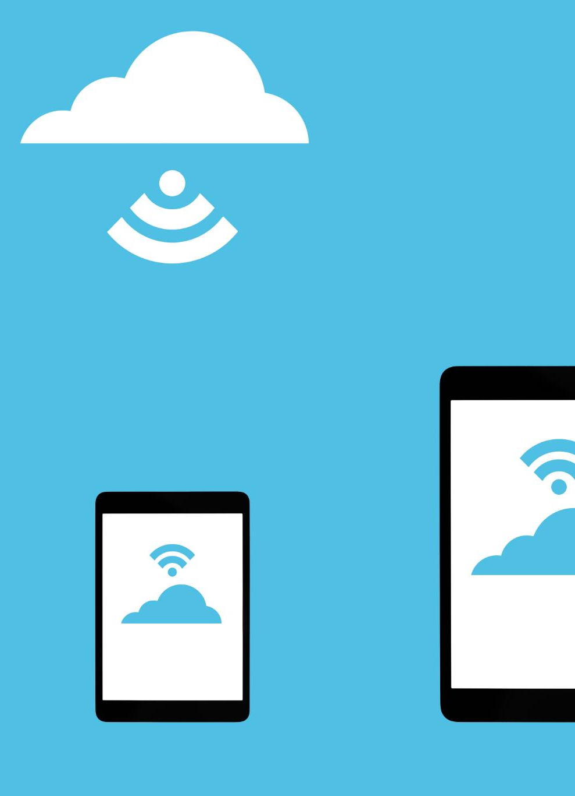
Azure Stencil Updates
New Azure Stencils
Additional Azure stencils have been introduced to enhance the stencil set with new features and functionalities.
Threats and Mitigations
Each new stencil includes associated threats and mitigations, providing better security guidance for users.
Focus Areas
Significant updates were made in areas such as Azure App Services, Database Offerings, and Azure Storage.
Notes:
--- This slide references information from the following file: https://sidharthmahajanhotmail-my.sharepoint.com/personal/trainer_trainings_vinsys_com/_layouts/15/Doc.aspx?sourcedoc=%7B120D7389-5687-4024-8D66-9CDFDA274330%7D&file=Getting%20started%20with%20the%20Threat%20Modeling%20Tool.docx&action=default&mobileredirect=true Azure stencil updates Additional Azure stencils and their associated threats and mitigations have been added to the stencil set shipping with this release. Significant changes were made in the focus areas of “Azure App Services”, “Azure Database Offerings”, and “Azure Storage.”

Slide 25
Conclusion
Importance of Threat Modeling
The Threat Modeling Tool is essential for development teams to enhance software security and protect sensitive information.
Identifying Threats
Effectively identifying potential threats allows teams to proactively address security vulnerabilities and enhance application safety.
Mitigating Risks
Mitigating threats ensures the development of safer applications, ultimately protecting sensitive data from potential breaches.
Notes:
In conclusion, the Threat Modeling Tool is an invaluable asset for any development team aiming to enhance their software security posture. By effectively identifying and mitigating threats, teams can create safer applications and protect sensitive data.

